Slide 2
Digital Forensics Lecture-14
By- Dr.subhranil Das
Assistant Professor
School of computer Science

Slide 3

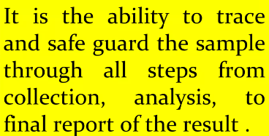
Definition of Chain of Custody

Slide 4
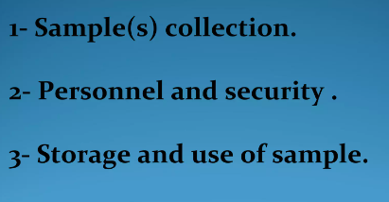
How to apply the chain of custody?

Slide 5
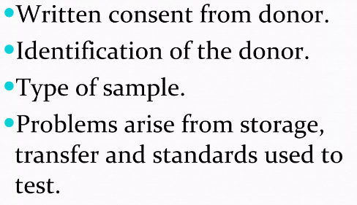
Collection of Sample

Slide 6
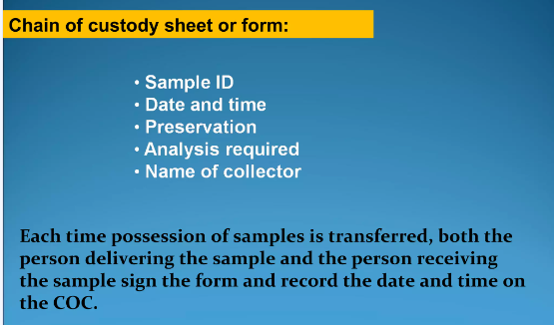
1. Sample Collection

Slide 7
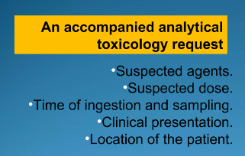
1. Sample Collection

Slide 8
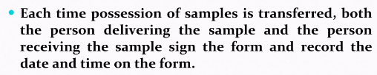
1. Sample Collection

Slide 9
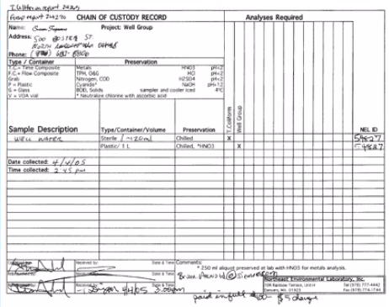
Chain of Custody form

Slide 10
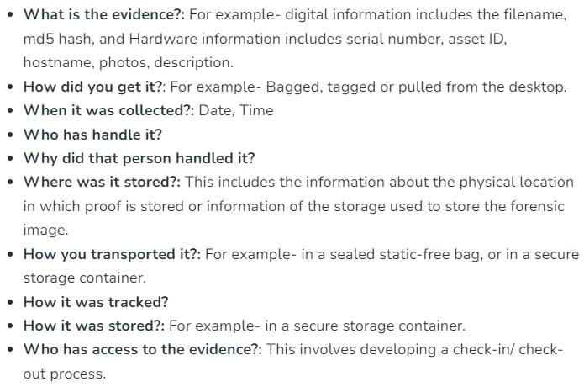
Chain of Custody form

Slide 11
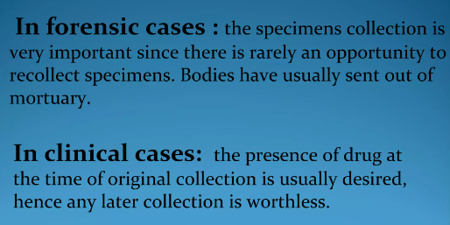
Sample Collection

Slide 12
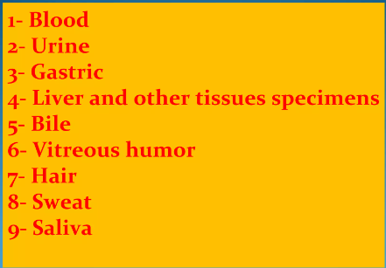
Specimens

Slide 13
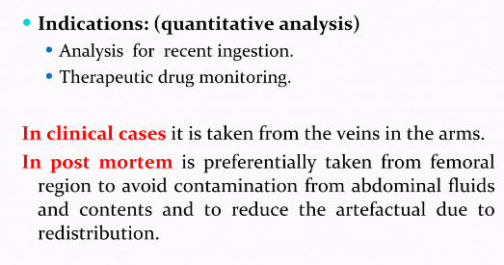
Blood specimen

Slide 14
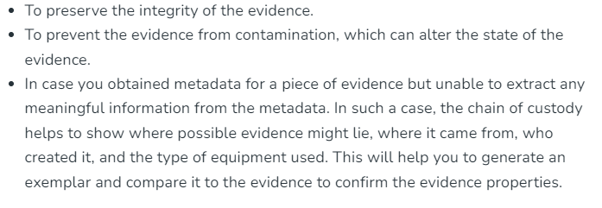
Importance of Examiner

Slide 15
Importance of Court
If not preserved, the evidence submitted in the court might be challenged and ruled inadmissible.

Slide 16
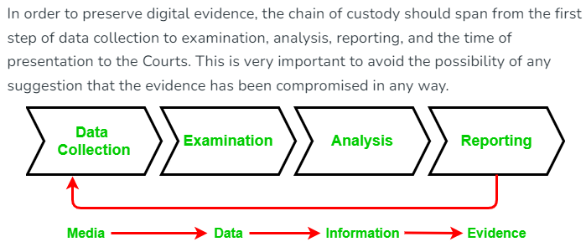
Chain of custody Process

Slide 17
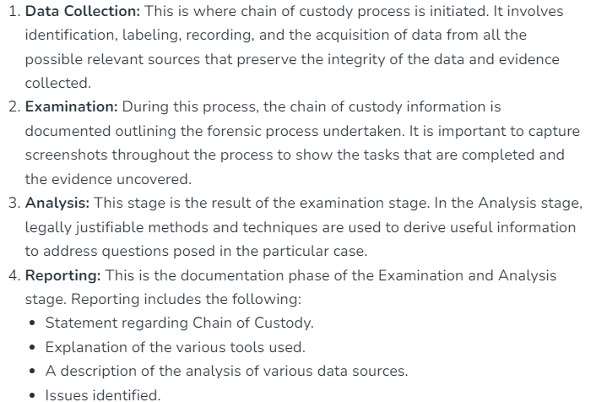
Chain of custody Process

Slide 18
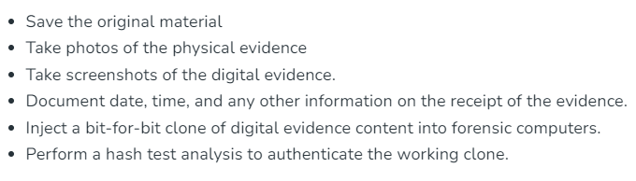
Procedure to obtain chain of custody

Slide 19
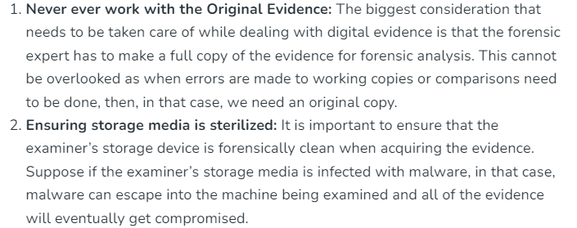
How can chain of custody is assured?

Slide 20
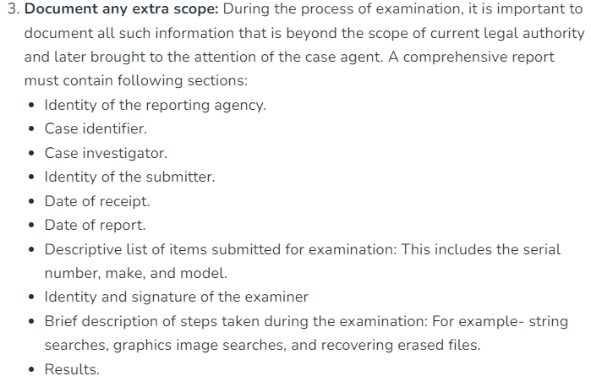
How can chain of custody is assured?

Slide 21
Next Lecture
Hands on exercise

